Slide 1


Course: CS5593 – Online Sections 995-999, Data Mining Semester: Fall 2024 Heart Disease Prediction and Patient Segmentation Students: Ferial NajianTabriz, Subankar Chowdhury, Ujwala Vasireddy Professor: Dr. Le Gruenwald YouTube link: https://youtu.be/kOKy8rFRgyU

Slide 2
Abstract
1

Slide 3

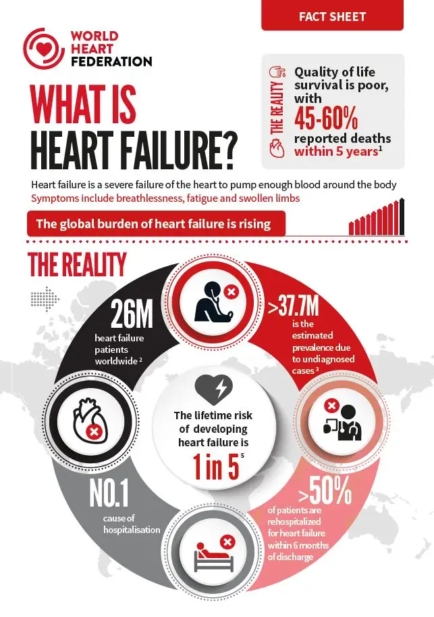
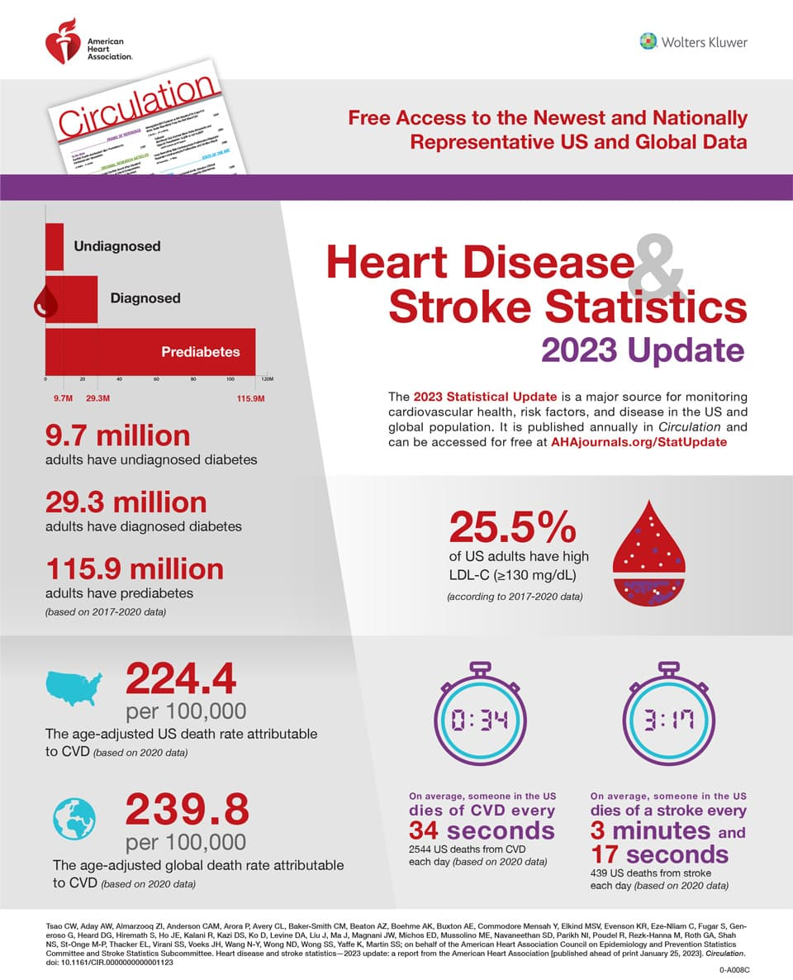
Global Health Challenge
Heart disease is a leading cause of death worldwide
Early prediction and risk assessment are crucial for improving outcomes

Slide 4
Introduction
2

Slide 5
Objectives
Predict heart disease risk using Logistic Regression, Decision Trees, and k-Nearest Neighbors (k-NN)
Segment patients based on medical characteristics to identify risk factors and trends
Provide actionable advice to patients based on their risk cluster
Patient Insights
High-risk clusters: Recommendations include dietary changes, physical activity, and health monitoring
Low-risk clusters: Emphasis on maintaining habits and regular check-ups

Slide 6
Heart Disease and Data Complexity
Dependency on subjective clinical judgment. Inability to effectively process large datasets in real-time.
Patient datasets often include noise, outliers, and missing values, complicating analysis.
Innovation in the Graphical Interface
Dynamic Recommendations: Tailored advice updates in real-time based on prediction results and cluster assignment.
Interactivity: Enables healthcare professionals to experiment with what-if scenarios by modifying input features.

Slide 7
Significance of Patient Segmentation
Uncover Hidden Trends: Clustering can reveal non-intuitive risk factors (e.g., a combination of moderate cholesterol and high age predicting high risk)
Resource Allocation: High-risk clusters help prioritize medical resources like intensive monitoring or preventive measures.
Differentiators of This System
Custom Algorithms: Implementation of models and clustering algorithms from scratch enhances understanding and customization.
Visualization-Driven Insights: Use of ROC curves, confusion matrices, and PCA scatter plots for better interpretability.

Slide 8

System Features
Graphical Interface: Allows data input and visualization of predictions/segmentations
Feature Importance: Highlights key factor
Patient Segmentation: Reveals distinct groups aligned with varying risk levels
Impact
Combines predictive modeling with user-friendly tools
Advances heart disease research by integrating data mining with actionable healthcare insights

Slide 9
Related Work
3

Slide 10
Notable Studies
Alousafat (2020): Analyzed machine learning classifiers (Decision Trees, SVM, k-NN, Neural Networks). Focus on model performance; lacks patient segmentation.
Ali et al. (2021): Compared supervised learning algorithms (Logistic Regression, Random Forest, etc.). Emphasized ensemble methods but didn’t include patient segmentation or clinical tools.
Bhatla and Jyoti (2012): Compared Naïve Bayes, Decision Trees, and Neural Networks. Focused on preprocessing but lacked interactive tools for healthcare professionals.
Chandrasekhar & Peddakrishna (2023): Hybrid models with Genetic Algorithms for feature selection. Focused on performance, but no emphasis on clinical implementation.
Dey & Bauratx (2014): Evaluated algorithms like SVM and k-NN. Focused on efficiency and accuracy but did not address patient segmentation or tool integration.
Soni et al. (2011): Discussed clustering and classification. Acknowledged importance of clustering but didn’t segment patients or provide visualizations.

Slide 11
Gaps Identified
Lack of patient segmentation to uncover hidden trends and enable personalized risk management.
Absence of user-friendly interfaces and visualization tools for clinical application, limiting practical adoption.
Need for better integration of predictive models with visualization to support decision-making.

Slide 12
Flowchart
4

Slide 13
Input Sources
Manual Input
Batch Upload
Data Preprocessing
Handle Missing Values
Encode Categorical Variables
Normalize Continuous Variables
Remove Outliers
Predictive Modeling
Logistic Regression
Decision Trees
K-Nearest Neighbors
Model Outputs
(Risk Scores: High, Low)
Continuation

Slide 14
Patient Segmentation
K-Means Clustering
Elbow Method (K = 4)
Cluster Analysis Outputs
(Cluster 1: High Risk, Cluster 0: Low Risk
Visualization Layer
Dynamic Charts (Risk Predictions, Cluster Distributions)
PCA Scatter Plots
Confusion Matrix
Recommendations Layer
High-Risk Clusters:
(Dietary Adjustments, Regular Monitoring, Physical Activity)
Low-Risk Clusters:
(Maintain Healthy Habits, Regular Check-Ups)

Slide 15
Dataset
5

Slide 16
UCI Machine Learning Repository
https://www.kaggle.com/datasets/johnsmith88/heart-disease-dataset
Dataset
Age: Age of the patient (years)
Sex: Gender (1 = male, 0 = female)
Chest Pain Type: Four types of chest pain (Typical, Atypical, Non-anginal, Asymptomatic)
Resting Blood Pressure: Measured in mm Hg
Serum Cholesterol: Measured in mg/dl
Fasting Blood Sugar: Indicator if fasting blood sugar > 120 mg/dl
Resting ECG Results: Normal or abnormal electrocardiogram results
Maximum Heart Rate: Highest heart rate achieved during exercise
Exercise-Induced Angina: Whether exercise triggers angina (1 = yes, 0 = no)
Oldpeak: Measure of ST depression induced by exercise
Slope of Peak Exercise ST Segment: Describes exercise-induced ST segment slope (Upsloping, Flat, Downsloping)
Major Vessels: Number of major blood vessels visualized by fluoroscopy
Thalassemia (Thal): Blood disorder status (Normal, Fixed defect, Reversible defect)
Target: Presence of heart disease (1 = presence, 0 = absence)

Slide 17
System Architecture
6

Slide 18
Methods for Data Entry
Batch Input:
Users can upload a CSV file with multiple patient records.
Enables processing of large datasets for predictions and segmentation.
Ideal for healthcare providers managing multiple patients at once.
Manual Input:
Allows entry of a single patient's details.
Provides immediate heart disease risk prediction and segmentation results.
Suitable for individual patient assessments.
Key Benefits
Dual-mode flexibility for diverse healthcare needs.
Efficient handling of both individual and large-scale patient data.

Slide 19
Preprocessing Layer
Key Benefits:
Categorical Variable Encoding: One-hot encoding for gender, chest pain type, etc.
Continuous Variable Normalization: Standardization for consistent analysis.
Outlier Removal: Interquartile Range (IQR) method to enhance data quality.
Missing Values: Imputation methods to preserve data integrity.
Prediction Module
Algorithms Used: Decision Tree & Logistic Regression (implemented from scratch).
Key Features: Focus on 7 important features (cp, thal, ca, oldpeak, age, thalach, cholesterol).
Real-Time Prediction: Immediate risk prediction with fewer features.
Batch Prediction: Process large datasets with important feature highlights.

Slide 20
Patient Segmentation Module
Custom K-Means Clustering: Developed from scratch.
Cluster Determination: Elbow Method to find optimal K.
Four Patient Groups:
Cluster 0: Older patients with high cholesterol and BP.
Cluster 1: Younger, healthy lifestyle with moderate activity.
Cluster 2: Normal BP and heart rate – routine monitoring.
Cluster 3: Higher oldpeak and risk factors requiring personalized care.

Slide 21
Visualization and Insights
Heart Disease Prediction Metrics:
Accuracy, Precision, Recall, F1 Score, Confusion Matrix.
Statistical significance tests (Chi-squared test).
ROC Curve and AUC for model performance.
Patient Segmentation Visualizations:
PCA scatter plots, Silhouette plots, and Pairwise comparisons.
Distribution of categorical features (e.g., chest pain types).

Slide 22
User Interface
Streamlit Interface: Simple, interactive, and user-friendly.
Input Methods: Manual entry or batch processing via CSV upload.
Dynamic Visualizations: Pair plots and feature distribution graphs.
Downloadable Data: CSV export for segmented data and recommendations.
Deployment
Current Deployment: Local Streamlit server for testing and prototyping.
Future Enhancements: Potential cloud deployment for scalability and wider accessibility.
Benefits of Cloud: Increased reach, scalability, and efficiency for real-world healthcare settings.

Slide 23
Data Preprocessing
7

Slide 24
Importance
Essential for high-quality input data and improved model performance in machine learning.
Key Preprocessing Steps:
Handling Missing Values: No missing data found, ensuring dataset completeness
Normalization: Continuous variables (age, cholesterol, heart rate, etc.) standardized to a mean of 0 and standard deviation of 1 for consistent model input.
Outlier Detection and Removal: Extreme values (outliers) exceeding three standard deviations removed, reducing dataset from 1025 to 946 records to improve model accuracy.
Outcome: Clean, reliable dataset ready for machine learning training, ensuring better model performance and efficiency in healthcare analytics.

Slide 25
Exploratory Data Analysis
8

Slide 26
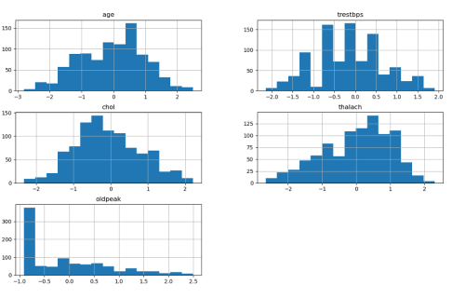
Continuous Data Analysis
Histograms of standardized variables (age, blood pressure, cholesterol, heart rate, oldpeak):
Normal distribution for most variables.
Right-skewed distribution for oldpeak.
Insight into data distribution and variability, highlighting trends and outliers.

Slide 27
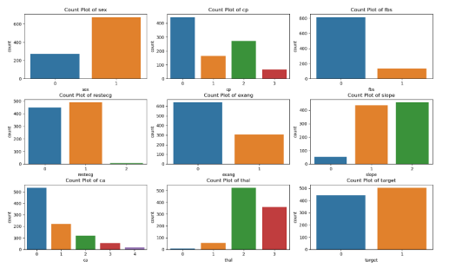
Categorical Data Analysis
Key Preprocessing Steps:
Visualize categorical variables (sex, chest pain type, fasting blood sugar, etc.).
Show diversity in the dataset: higher proportion of male patients and varied distributions in categories like chest pain and thalassemia.
Highlights the need for encoding during preprocessing for accurate modeling.

Slide 28
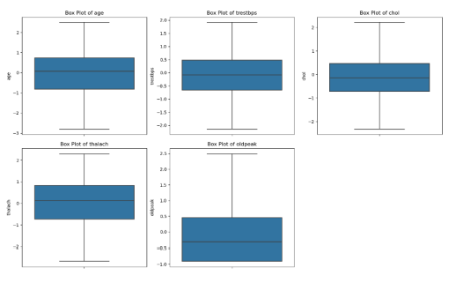
Outlier Detection and Removal
Box Plots:
Visualize continuous features (trestbps, chol) post-outlier removal.
Ensures improved model robustness by removing extreme values.
Managing outliers is crucial for model accuracy in medical data.

Slide 29
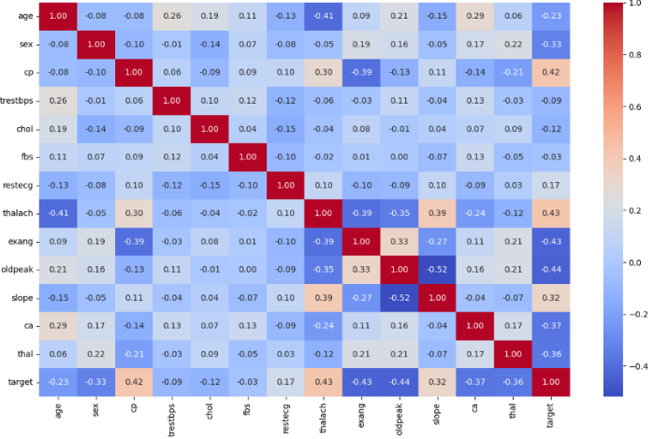
Correlation matrix
Key Findings:
Strong Positive Correlation:
Thalach <-> Target
Strong Negative Correlation:
Oldpeak <-> Target
Weaker Correlations:
Features like Age and Chol with the target variable
Identifies critical variables for feature selection
Emphasize the value of understanding variable interactions for accurate predictions

Slide 30
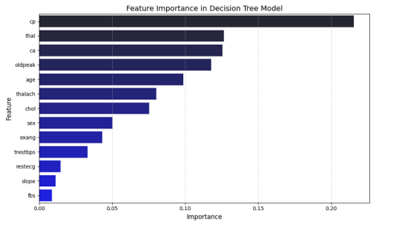
Feature Importance
Importance across Models:
Visualizations from Decision Tree (DT), Logistic Regression (LR), and K-Nearest Neighbors (KNN) models.

Slide 31
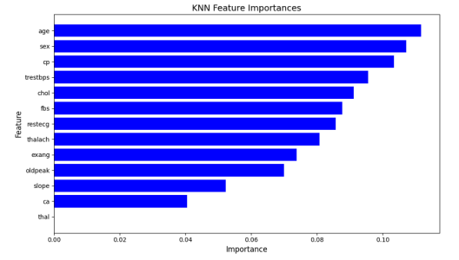
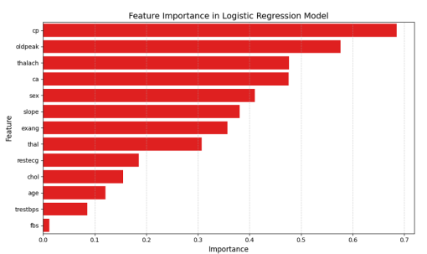

Slide 32
Key Findings
Decision Tree identifies cp, thal, and ca as the most important features.
Logistic Regression also identifies cp and oldpeak, but with slightly different rankings.
KNN shows a more even distribution of feature importance, making it less effective in identifying key features.
We Chose Decision Tree
Captures nonlinear relationships and feature interaction, crucial for heart disease prediction.
Easy to interpret, making it suitable for explaining to non-technical audiences.
Reliable and practical for both predictions and clear result explanations.

Slide 33
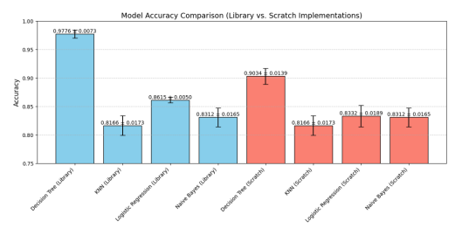
Model Selection: Decision Tree
Decision Tree Model:
Captures important features for heart disease prediction: chest pain type, thalassemia status, etc.
Chosen due to its ability to explain results to non-technical audiences and interpret relationships clearly.

Slide 34
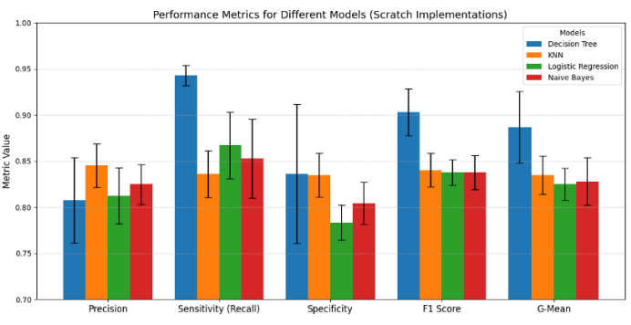
Performance Metrics Comparison Across Decision Tree (DT), K-Nearest Neighbors (KNN), Logistic Regression (LR), Naive Bayes (NB) models.

Slide 35
Key Findings
Decision Tree:
Best in Sensitivity (Recall) and F1 Score, excelling in identifying positive cases and minimizing false negatives.
Achieves highest G-Mean, balancing Sensitivity and Specificity.
KNN and Logistic Regression:
Perform similarly but with slightly lower precision and sensitivity than the Decision Tree.
Naïve Bayes:
Struggles with Specificity and F1 Score, performing worst overall.
Has the lowest G-Mean, indicating difficulties with imbalanced data.

Slide 36
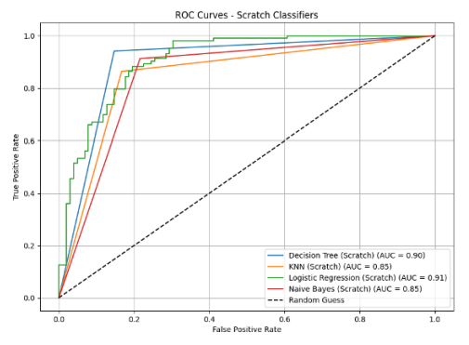
ROC Curves for Model Comparison
ROC Curves:
X-axis: False Positive Rate
Y-axis: True Positive Rate
Insight: Logistic Regression and Decision Tree are the most reliable classifiers for distinguishing between classes.

Slide 37
ROC Curve Analysis
AUC Values :
Logistic Regression: 0.91
Decision Tree: 0.90
k-NN: 0.85
Naive Bayes: 0.85
Insight: Logistic Regression and Decision Tree show superior ability to balance sensitivity and specificity.

Slide 38
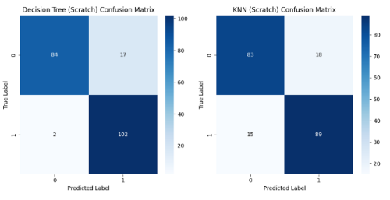
Confusion Matrix Analysis
Key Findings from Confusion Matrices
Decision Tree: Best performance with few misclassifications.
k-NN: Higher misclassification of positive instances.

Slide 39
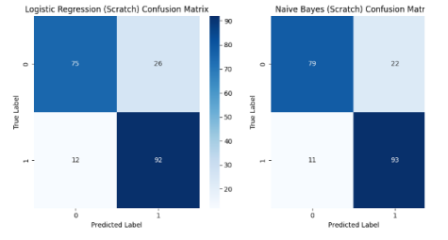
Confusion Matrix Analysis
Key Findings from Confusion Matrices
Logistic Regression & Naive Bayes: Similar results with logistic regression showing slightly higher false positives.

Slide 40
Decision Tree Was Chosen
High Accuracy:
Outperformed other models in predicting heart disease risk.
Interpretability:
Easy to understand and visualize, aiding in clinical decision-making.
Feature Importance:
Allows identification of key predictive features (e.g., cholesterol, chest pain type).
Clinician Insights:
Provides valuable guidance into factors contributing to heart disease risk.

Slide 41
Segmentation
9

Slide 42
Implemented K-Means, Hierarchical Clustering, and Gaussian Mixture Model (GMM).
Optimal clusters (𝐾 = 4) determined via the Elbow Method.
K-Means was the most effective, offering balanced clusters and computational efficiency.
Challenges:
Hierarchical Clustering: Imbalanced clusters.
GMM: Assumptions of Gaussian distributions caused less meaningful separations.
K-Means Outcome: Best separation for identifying distinct patient groups

Slide 43
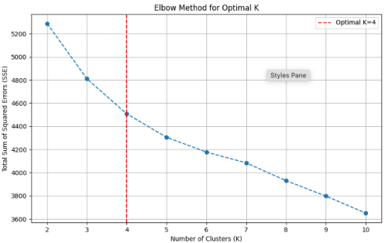
Elbow Method for K-Means Clustering
Elbow Method:
X-axis: Number of clusters.
Y-axis: Total Sum of Squared Errors (SSE).
Clear "elbow" at K = 4, marked by a red dashed line, balancing SSE minimization and avoiding overfitting.
Visual:
A graph of SSE vs. the number of clusters with a red dashed line at K=4.

Slide 44
Analysis of Clustered Data Using Pairwise Scatterplots
Relationships among key variables: age, trestbps, chol, thalach, oldpeak.
Diagonal plots: Feature distributions within clusters.
Off-diagonal plots: Pairwise relationships.
Insights:
Cluster 2 (pink): Younger individuals with low blood pressure and cholesterol.
Cluster 3 (blue): Diverse ages and exercise tolerance.
Clusters 0 (orange) and 1 (green): Moderate distributions indicating intermediate risk.
Application:
Helps identify high/low-risk groups for targeted interventions.

Slide 45
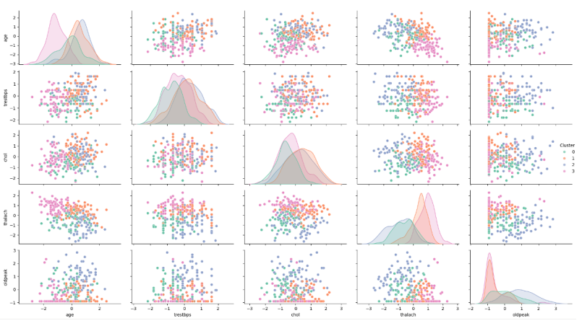
Visual: Pairwise scatterplot matrix with clusters represented by distinct colors

Slide 46
Silhouette Plot for K-Means Clustering
Measures clustering quality using silhouette coefficient:
Ranges from -1 (poor) to 1 (good).
Most clusters have positive scores, indicating well-grouped points.
Some overlap near zero suggests ambiguous points.
Recommendations:
Refine features or explore different KKK-values.

Slide 47
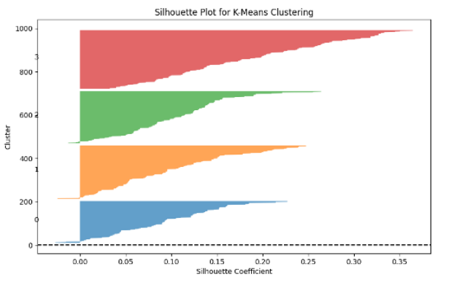
Visual: Silhouette plot showing cluster scores with bar thickness reflecting data point density

Slide 48
Cluster Distribution of Categorical Features
Features Analyzed:
Sex, Chest Pain Type (cp), Fasting Blood Sugar (fbs).
Insights:
Unique distribution patterns across clusters.
Example: Higher specific category proportions in Cluster 2 and 3.

Slide 49
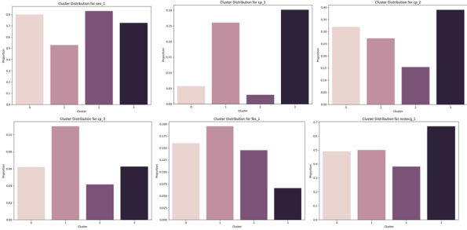
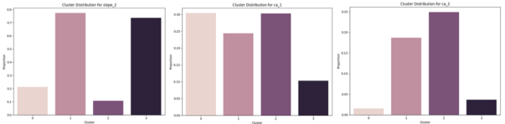
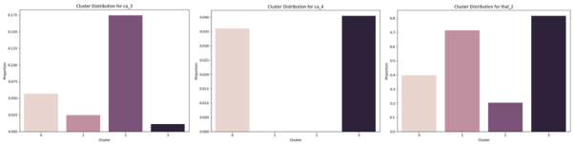
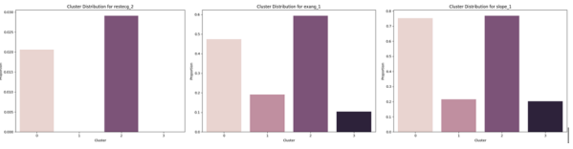
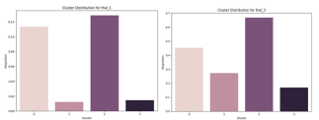
Visual: Bar charts showing categorical feature distributions

Slide 50
Comparison of Clustering Techniques
Comparison Metrics:
Balance, Efficiency, Interpretability.
Key Results:
K-Means: Balanced clusters and computational efficiency.
Hierarchical Clustering: Imbalanced but hierarchical relationships revealed.
GMM: Poor cluster separation due to Gaussian assumptions.

Slide 51
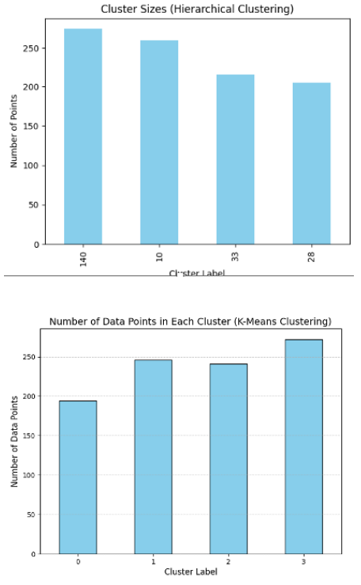
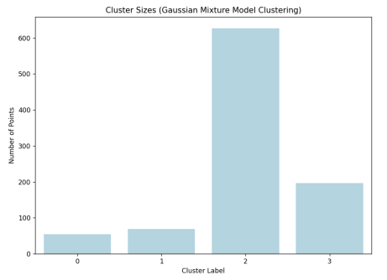
Visual: Distribution comparison for all techniques

Slide 52
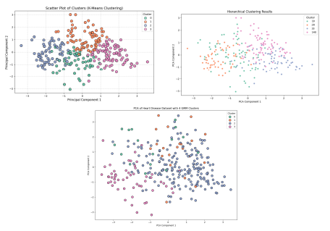
PCA Visualization of Clustering Results
Principal Component Analysis (PCA):
Dimensionality reduction to visualize clustering.
Findings:
K-Means: Well-separated, balanced clusters.
Hierarchical Clustering: Overlapping clusters.
GMM: Imbalanced results.
Visual: PCA scatter plots for each clustering method

Slide 53
Application Overview and User Interface
Application Features:
Predict heart disease risk using Decision Tree and Logistic Regression.
Segment patients using K-Means clustering.
User Interface (UI):
Main Page: Introduction and navigation.
Input Modes: CSV uploads and manual data entry.

Slide 54
Conclusion
10

Slide 55
Impact on Healthcare:
Successfully applied data mining and machine learning to predict heart disease and segment patients.
Tools like Decision Trees, Logistic Regression, and K-Means Clustering provided actionable insights.
Significant Predictors Identified:
Cholesterol Levels, Chest Pain Type, and ST Depression emerged as key factors.
User-Friendly Application :
Empowered healthcare providers with accessible prediction and clustering tools.
55

Slide 56
Future Work
11

Slide 57
Scalability:
Evaluate models on larger, diverse datasets for improved generalizability.
Enhanced Accuracy:
Incorporate ensemble methods like Random Forest and Gradient Boosting.
Advanced Features:
Implement feature engineering techniques for refined predictions.
Real-World Deployment:
Integrate with Electronic Health Records (EHR) and ensure robust security measures.
Expansion:
Extend the system to predict risks for other diseases, such as diabetes and stroke.
57

Slide 58
Thank you

